Slide 1
CSCI 202
HTML & CSS

Slide 2
What is HTML?
Hyper Text Markup Language.
NOT a programming language
Markup Language for creating web pages/ document
Building blocks of the Web
What you’ll need A Web Browser
Google Chrome *
Mozilla Firefox
A Text Editor

Slide 3
Creating an HTML file
Does NOT need a server
Files must end with the .html extension
Runs in a web browser (Chrome, FireFox, etc)
index.html is the root / home page of a website
http://www.something.com
Loads the index.html file
http://www.something.com/about.html
Loads the about.html file

Slide 4
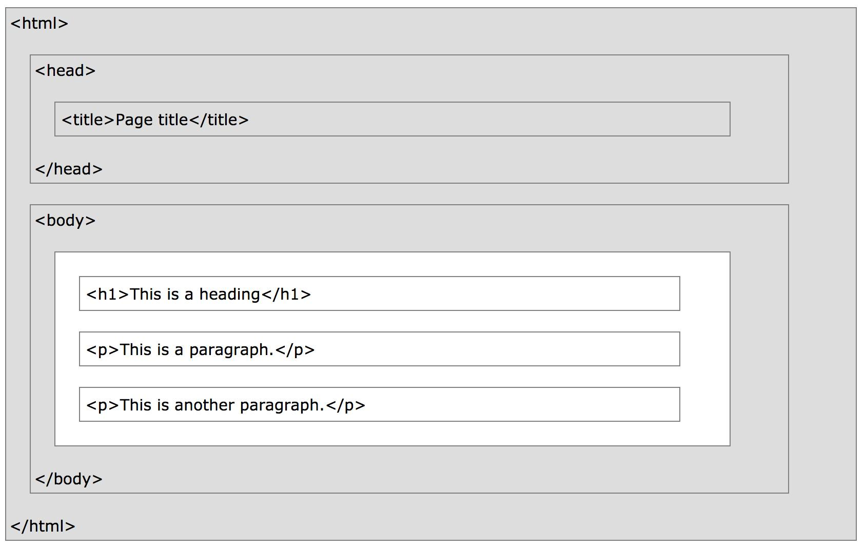
HTML Page Structure

Slide 5
Page (HTML5) Template
<!DOCTYPE html>
<html lang="en">
<head>
<title>Page Title Goes Here</title>
<meta charset="utf-8">
</head>
<body>
… body text and more HTML tags go here …
</body>
</html>

Slide 6
Head & Body Sections
Head Section Contains information that describes the web page document
<head>
…head section info goes here
</head>
Body Section Contains text and elements that display in the web page document <body>
…body section info goes here
</body>

Slide 7
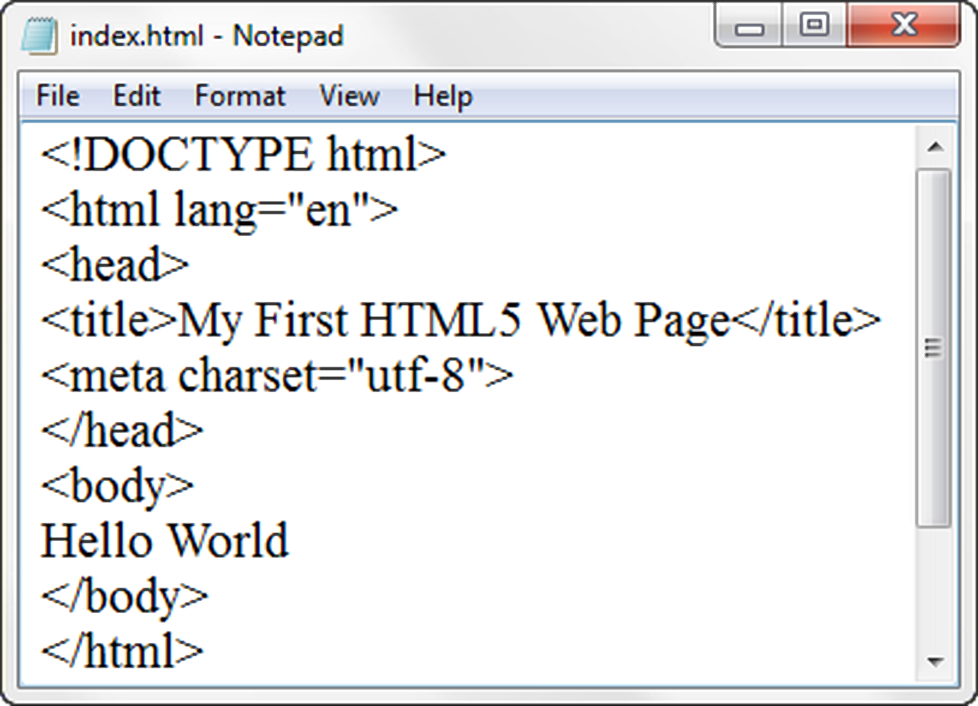
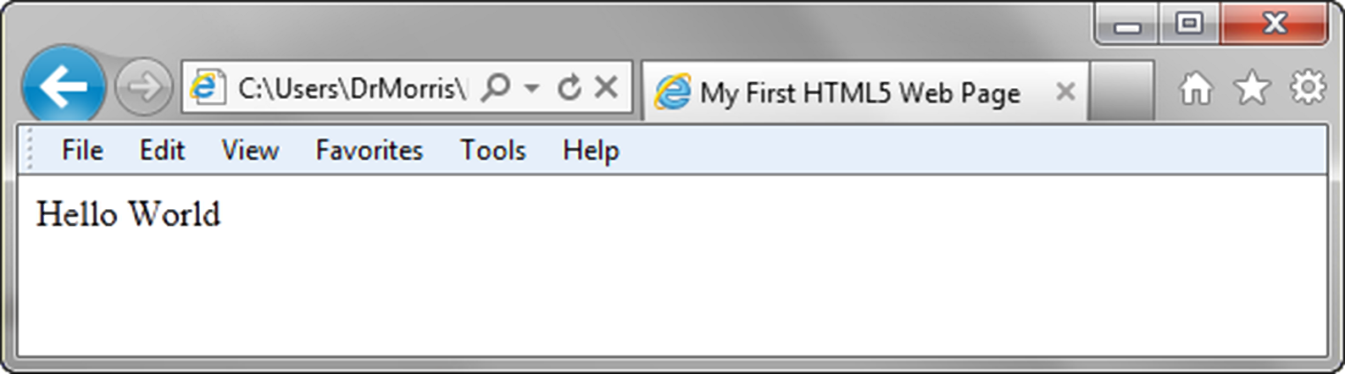

Slide 8
HTML Tags
HTML tags are keywords surrounded by angle brackets
<html> , <body> , <h1>
HTML tags normally come in pairs, with opening and ending tags
<tagname>content</tagname>
<h1>Hello World</h1>

Slide 9
What goes in the body?

Slide 10
Headings
Heading elements are organized into six levels.
Headings are defined with the <h1> to <h6> tags.
<h1> defines the most important heading.
<h6> defines the least important heading.
<h1>This is heading 1</h1> <h2>This is heading 2</h2>
. . . <h6>This is heading 6</h6>

Slide 11
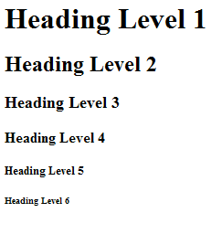
Headings
<h1>Heading Level 1</h1>
<h2>Heading Level 2</h2>
<h3>Heading Level 3</h3>
<h4>Heading Level 4</h4>
<h5>Heading Level 5</h5>
<h6>Heading Level 6</h6>

Slide 12
Comments
Comments can be added to your HTML source by using the following syntax:
<!-- Write your comments here -->
Comments are not displayed by the browser.

Slide 13
Paragraphs Element
The HTML <p> element defines a paragraph:
Groups sentences and sections of text together.
<p>Paragraph 1</p> <p>Paragraph 2</p> <p>Paragraph 3</p>
Notes:
Groups sentences and sections of text together.

Slide 14
Line Breaks
The <br> tag inserts a single line break.
The <br> tag is an empty tag which means that it has no end tag.
<p>Principles and technologies <br>
required to produce and <br>
distribute Web content<br>
</p>
Notes:
Causes the next element or text to display on a new line

Slide 15
The Horizontal Rule
The <hr> tag inserts a horizontal line on the page.
<hr>
Notes:
Causes the next element or text to display on a new line

Slide 16
The Blockquote Element
Blockquote element Indents a block of text for special emphasis
Semantically appropriate for long quotations
<blockquote>
…text goes here…
</blockquote>
Notes:
Configures empty space above and below

Slide 17
HTML Block and Inline Elements
One of the most important attributes of an element is its display. The two most common are block and inline
block (can take width and height)
Newline is inserted before and after, e.g. it “Takes up” whole width (e.g. <p> , <h1> … <h6>, <form>, <div> etc. )
inline (can not take width and height)
Only uses as much space as needed to contain the element. (e.g. <a> , <img>, <span> etc. )

Slide 18
Phrase Elements
HTML also defines special elements for defining text with a special meaning.
<b>Bold</b>
<i>Italic</i>
<big>Big text</big>
<small>Small text</small>
<strong>Important text</strong>
<em>Emphasized text</em>

Slide 19
HTML Lists
An Unordered List
An Ordered List
Description List
<ul>
<li>Item 1</li>
<li>Item 2</li>
...
</ul>
Notes:
Description List – formerly called a definition list

Slide 20
HTML Lists
An Unordered List
An Ordered List
Description List
Formerly called a definition list
Notes:
Description List – formerly called a definition list

Slide 21
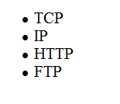
Unordered Lists
Displays a bullet, or list marker, before each entry in the list.
An unordered list starts with the <ul> tag.
<ul>
<li>TCP</li>
<li>IP</li>
<li>HTTP</li>
<li>FTP</li>
</ul>

Slide 22
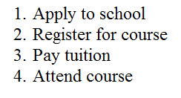
Ordered Lists
An ordered list starts with the <ol> tag.
List items are marked with numbers.
<ol>
<li>Apply to school</li>
<li>Register for course</li>
<li>Pay tuition</li>
<li>Attend course</li>
</ol>

Slide 23
Definition Lists
A definition list is a list of terms, with a description of each item and is defined using <dl> tag.
<dt> defines an item in the list and <dd> describes the item.
<dl>
<dt>IP</dt>
<dd>Internet Protocol</dd>
<dt>TCP</dt>
<dd>Transmission Control Protocol</dd>
</dl>

Slide 24
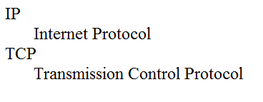
Description List Example
<dl>
<dt>IP</dt>
<dd>Internet Protocol</dd>
<dt>TCP</dt>
<dd>Transmission Control Protocol</dd>
</dl>

Slide 25

What is CSS3 ?
CSS3 - Cascading Style Sheets language.
Some important CSS3 modules are:
Selectors
Box Model
Backgrounds and Borders
Image Values and Replaced Content
Text Effects
2D/3D Transformations
Animations
Multiple Column Layout
User Interface

Slide 26
CSS3 Selectors
selectors reference a .classname, #id, or element.
.circle{width:150px;
height: 150;
border-radius: 50%;}
#circle1{width:150px;
height: 150;
border-radius: 50%;}
div{width:150px;
height: 150;
border-radius: 50%;}

Slide 27
CSS3 Position
The position property specifies the type of positioning method used for an element. There are five different position values:
static - default position, order of elements on the page
relative - to its default position
fixed - stays in same spot as page scrolls
absolute - relative to the nearest positioned ancestor or html body
sticky - toggles between relative and fixed, depending on the scroll position

Slide 28
CSS3 Position
The position property specifies the type of positioning method used for an element. There are five different position values:
static - default position, order of elements on the page
relative - to its default position
fixed - stays in same spot as page scrolls
absolute - relative to the nearest positioned ancestor or html body
sticky - toggles between relative and fixed, depending on the scroll position
#circle1{ position: fixed; bottom: 10px; right: 0; width:150px;
height: 150;
border-radius: 50%; background-color: green; }

Slide 29
CSS3 Position
The position property specifies the type of positioning method used for an element. There are five different position values:
static - default position, order of elements on the page
relative - to its default position
fixed - stays in same spot as page scrolls
absolute - relative to the nearest positioned ancestor or html body
sticky - toggles between relative and fixed, depending on the scroll position
#circle1{ position: absolute; top: 10px; left: 50px; width:150px;
height: 150;
border-radius: 50%; background-color: green; }

Slide 30
CSS3 Rounded Corners
With the CSS3 border-radius property, you can give any element "rounded corners".
div{ width: 200px;
height: 300;
border-radius:25px; background-color: green; }

Slide 31
CSS3 Backgrounds
CSS background-image property configures a background image.
div{ background-image: url(image.jpg);
}

Slide 32
CSS3 Backgrounds
CSS background-repeat property configures the behavior of an image.
div{ background-image: url(image.jpg);
background-repeat: no-repeat;
}

Slide 33
CSS3 Background Size
The CSS3 background-size property allows you to specify the size of background images.
div{ background-image: url(image.jpg);
background-repeat: no-repeat;
Background-size: 100px 80px;
}

Slide 34
CSS3 Colors
CSS3 also introduces:
RGBA colors
HSL colors
HSLA colors
opacity.
div{background-color: rgba(255,0,0,0.3);}
div{background-color: hsl(120,100%,50%);}
div{background-color: hsla(120,100%,0.3);}

Slide 35
CSS3 Colors
CSS3 also introduces:
RGBA colors
HSL colors
HSLA colors
opacity.
div{background-color: rgb(255,0,0)
opcity:0.3);
}

Slide 36
CSS3 Gradients
CSS3 gradients let you display smooth transitions between two or more specified colors.
div{height:300px;
background: red;
background: linear-gradient(left, blue, white);
}

Slide 37
CSS3 Transitions
CSS3 transitions allows you to change property values smoothly (from one value to another), over a given duration.
div{height:100px;
Width: 100px
background: red;
transition: width 2s, height 3s;
}
div: hover{width:300px; height:300px;}

Slide 38
Specify the Speed Curve of the Transition
The transition-timing-function property specifies the speed curve of the transition effect.
#div1 {transition-timing-function: linear;}
#div2 {transition-timing-function: ease;}
#div3 {transition-timing-function: ease-in;}
#div4 {transition-timing-function: ease-out;}
#div5 {transition-timing-function: ease-in-out;}

Slide 39
CSS3 Images
Rounded Images
Use the border-radius property to create rounded images:
img{border-radius: 50%;}
<img src="paris.jpg" width="300" height="300">

Slide 40
CSS3 Images Text
We can use CSS3 to position text in an image
div{position: relative;}
text{ position: absolute;
top: 50%;
left: 50%;
transform: translate(-50%, -50%);
font-size: 18px;}

Slide 41
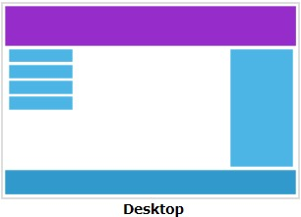

CSS3 Media Queries
What is a Media Query?
Media query is a CSS technique introduced in CSS3.
It uses the @media rule to include a block of CSS properties only if a certain condition is true.

Slide 42
CSS3 Media Queries
Media queries in CSS3 helps with the capability of devices.
Responsive web design refers to progressively enhancing a web page for different viewing contexts.
Smartphone: 320px, Tablet: 768px, Netbook: 1024px, Desktop: 1600px
@media only screen and (min-width: 480px) {
body {
background-color: lightgreen;
}
}

Slide 43
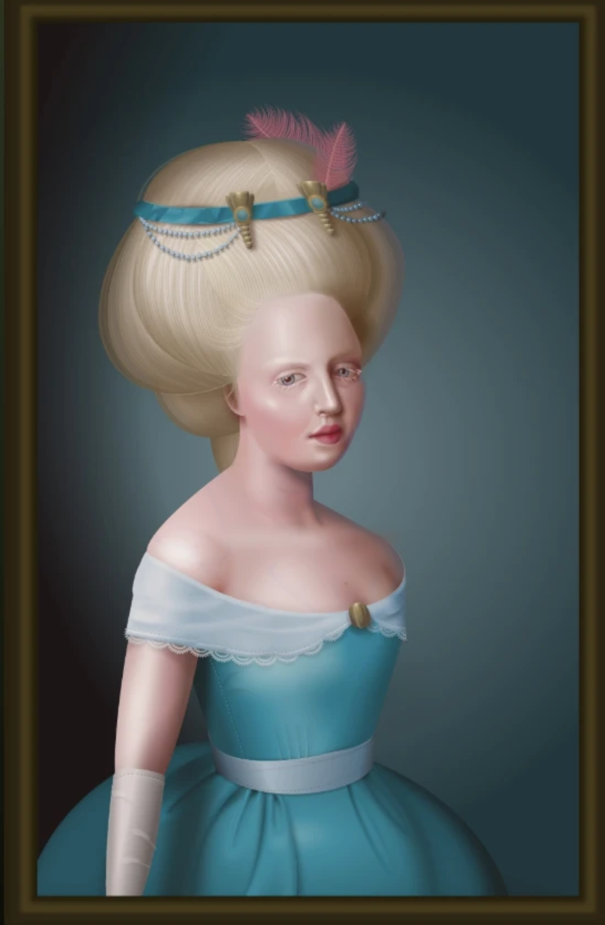

Design with CSS3
https://github.com/cyanharlow/purecss-zigario

Slide 44
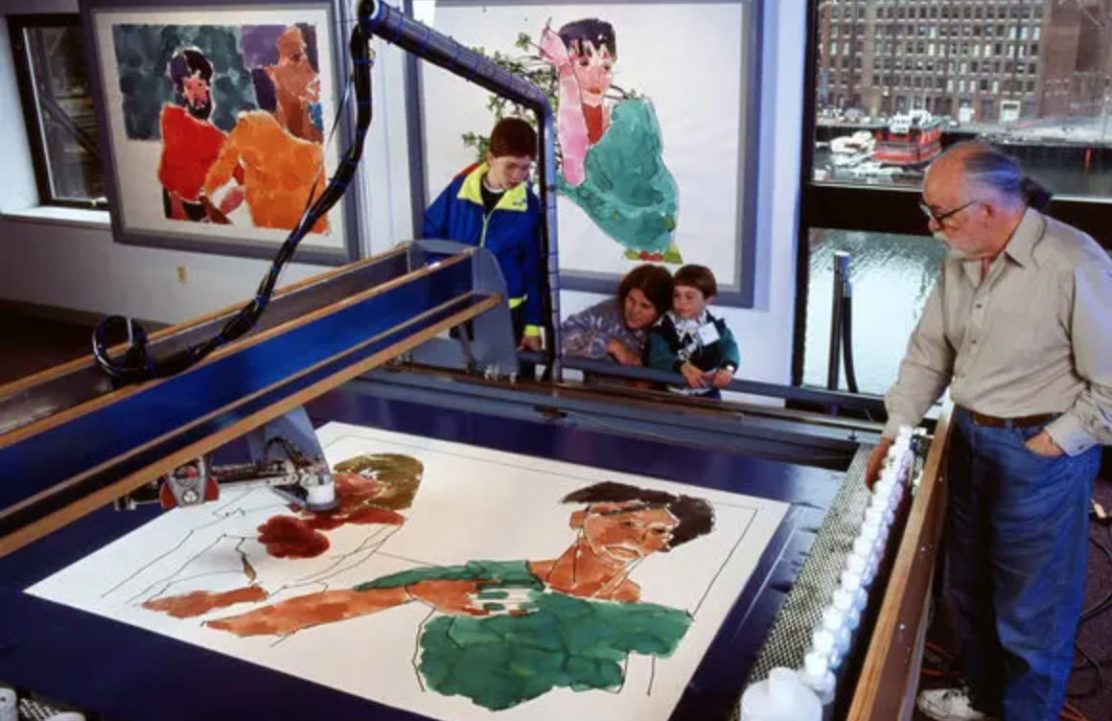

HAROLD COHEN & AARON

Slide 45
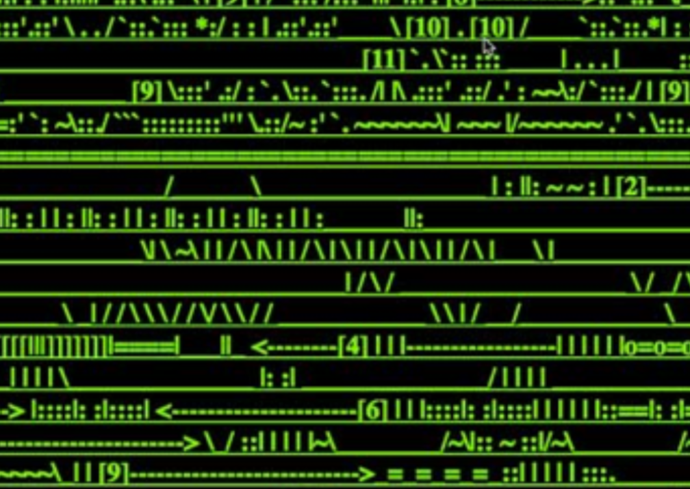
http://wwwwwwwww.jodi.org/

Slide 46
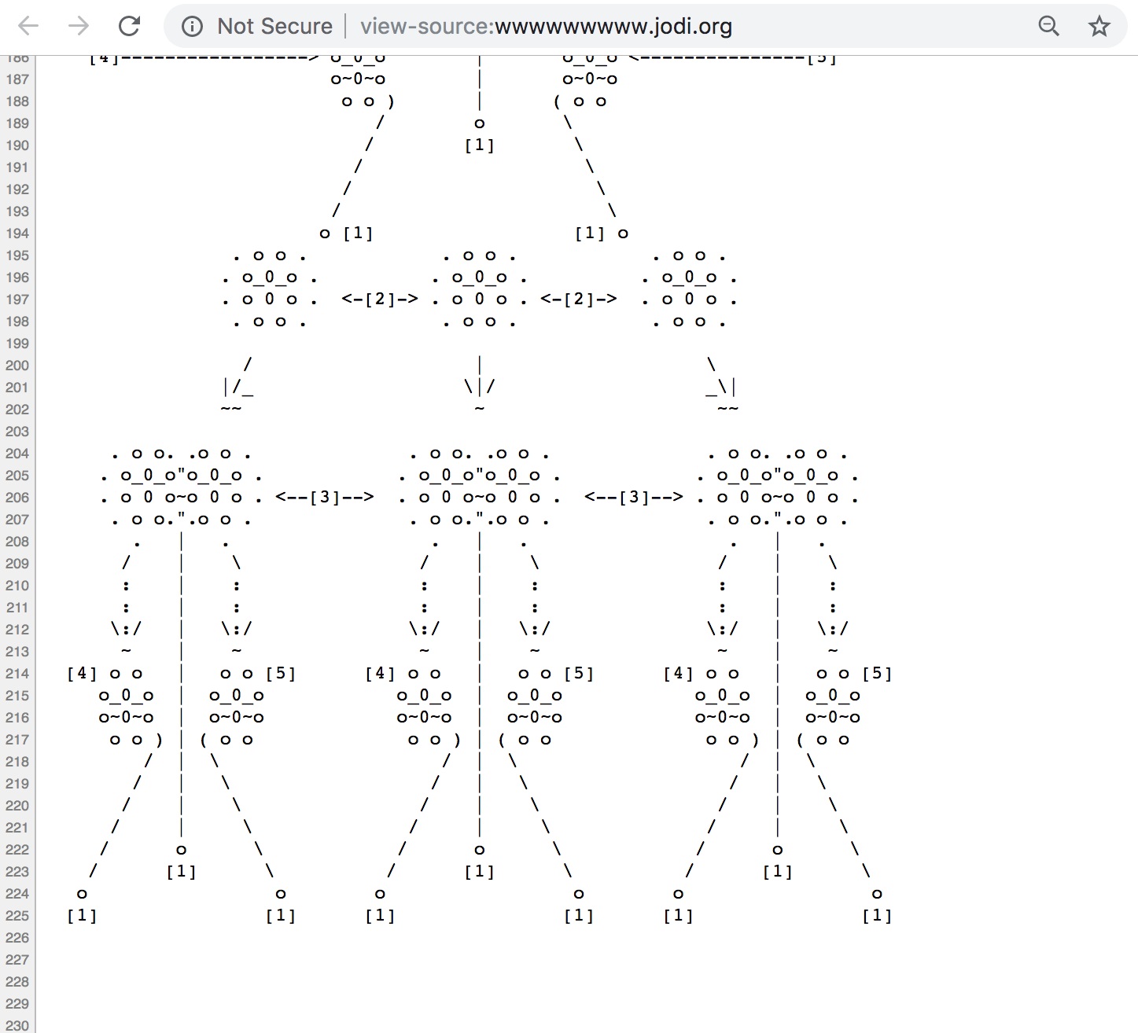
http://wwwwwwwww.jodi.org/

Slide 47


Casey Reas: http://reas.com/p6_images3_p/

Slide 48
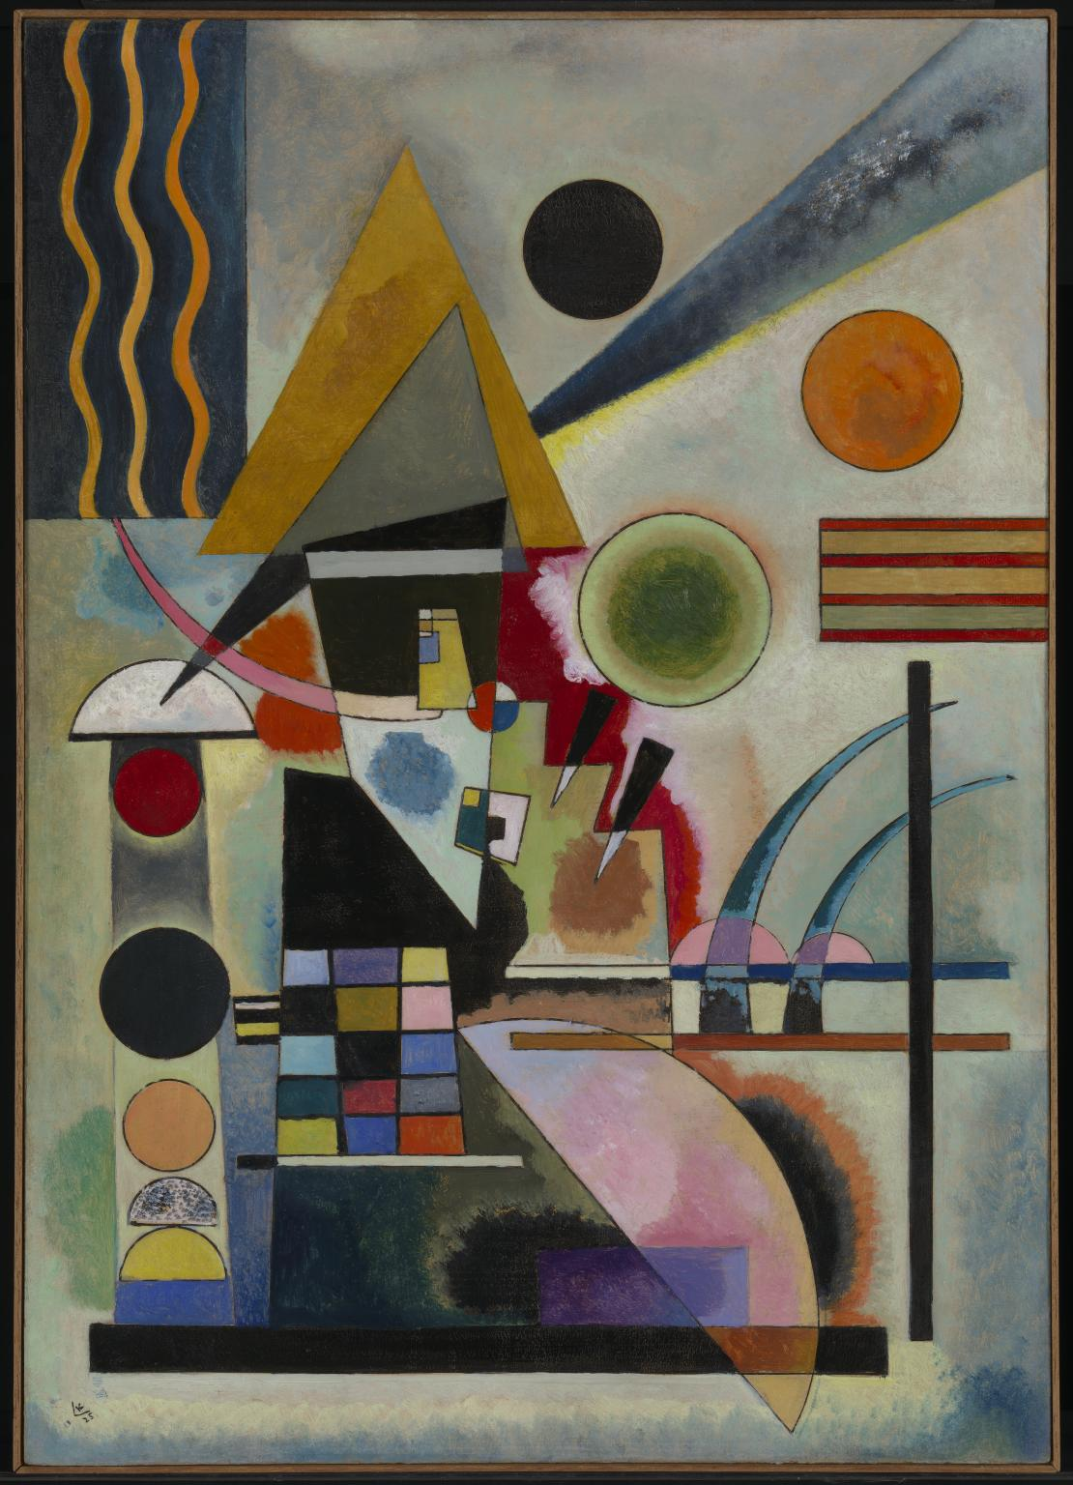

Wassily Kandinsky Swinging 1925
Jono Brandel’s reproduction of Swinging

Slide 49
Today’s Exercise
Reproduce a painting in the web browser. Select one of the paintings from the list below. Using HTML and CSS reproduce the visual design. Do not use any embedded images. All visuals should be written using some combination of html, css, and javascript. Most of this assignment can be done using CSS, but for students that feel ready, they can use javascript libraries designed for creating dynamic visuals (such a p5.js or two.js).

Slide 50
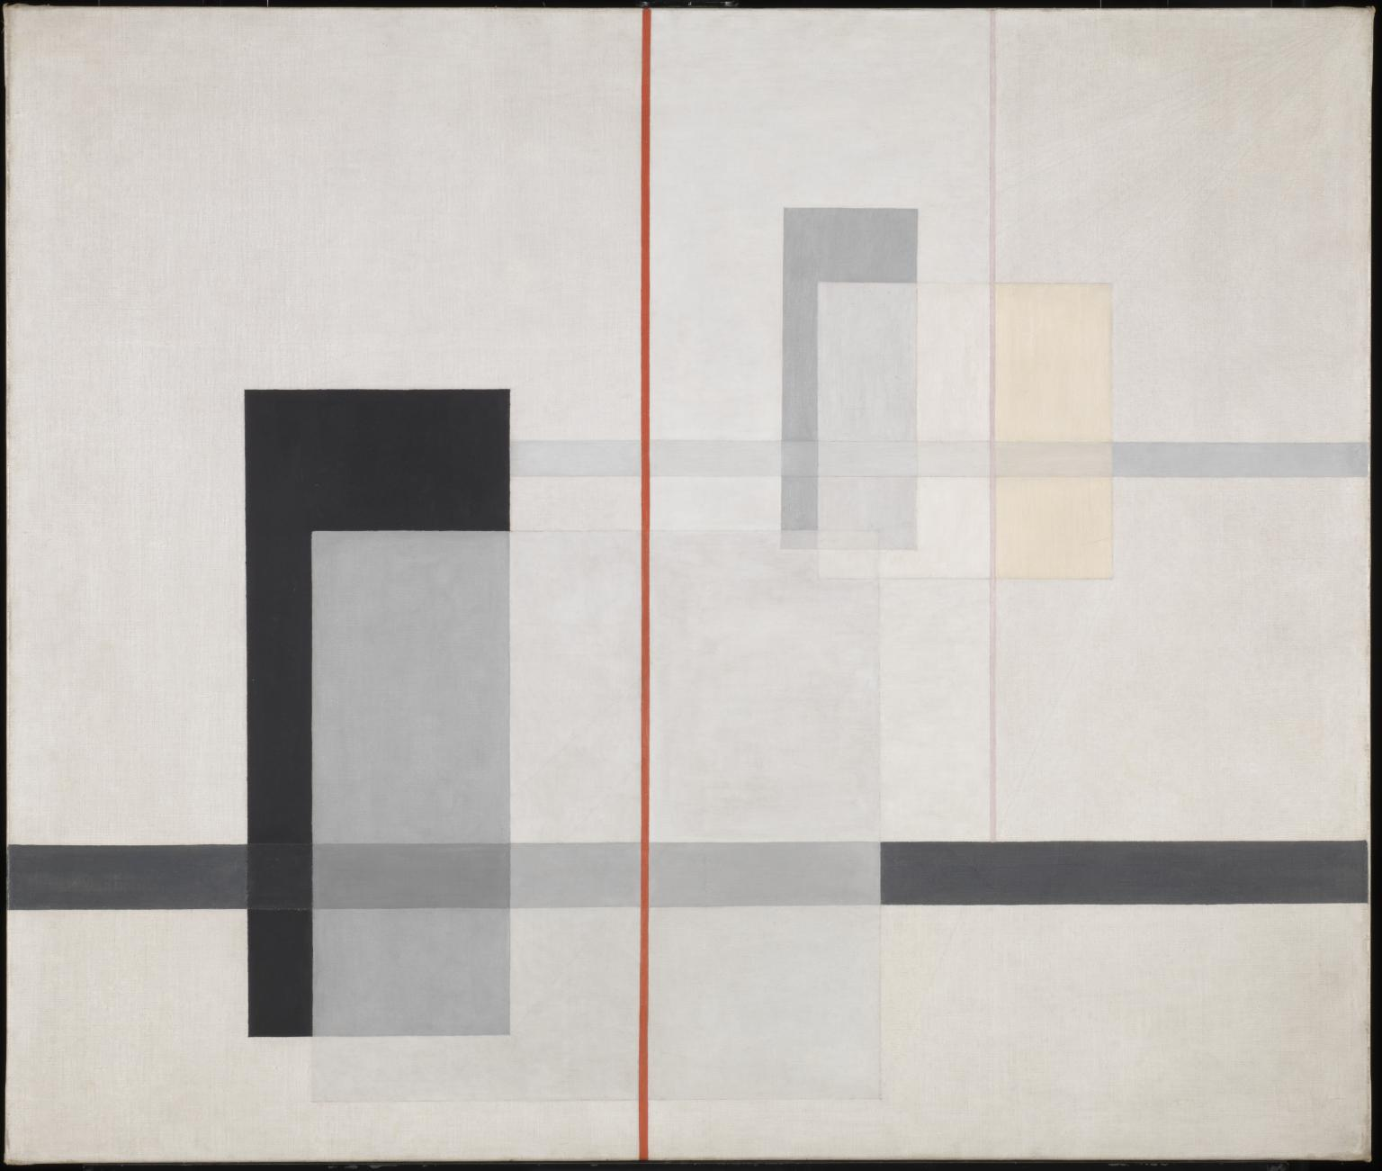
László Moholy-Nagy
K VII 1922

Slide 51
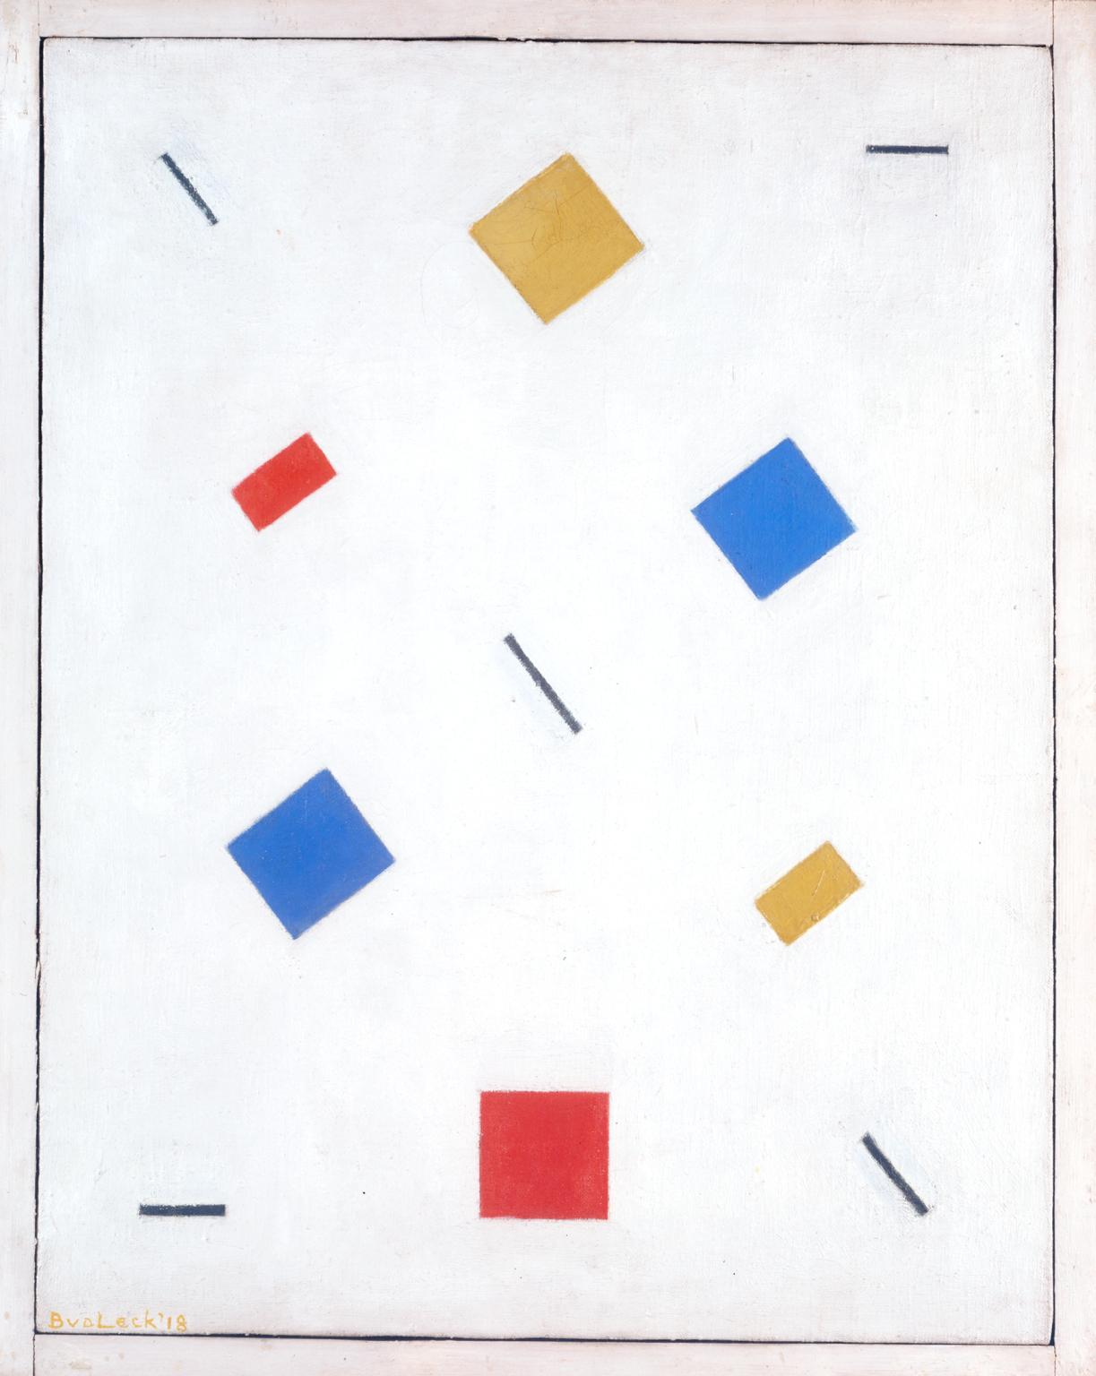
Bart van der Leck Composition 1918

Slide 52
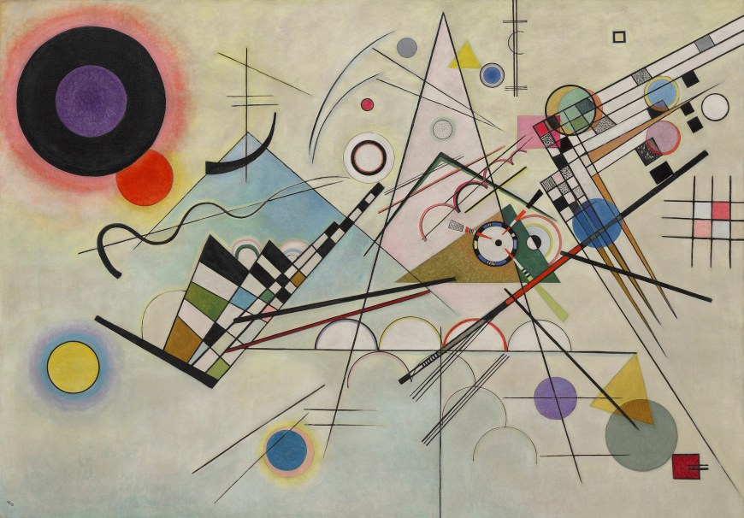
Wassily Kandinsky Composition III, 1923

Slide 53

Charles Demuth, Figure 5 in Gold, 1928

